Slide 1
18ITT42 - DESIGN AND ANALYSIS OF ALGORITHMS (IV-Semester)
Velalar College of Engineering and Technology
(Autonomous)
Department of CSE
(Accredited by NBA)
Handled By:
Dr.V.Latha Jothi , Professor

Slide 2
UNIT – II
Analysis of Sorting and Searching Algorithms
Brute Force – Selection Sort and Bubble Sort - Divide and conquer – Merge sort – Quick Sort-Strassen‟s Matrix Multiplication -Decrease and Conquer – Insertion Sort–Transform and Conquer-Heaps and Heap sort- Analysis of Linear Search and Binary search techniques

Slide 3
TRANSFORM AND CONQUER

Slide 4
TRANSFORM AND CONQUER
Problems under these methods work as two-stage procedures.
First, in the transformation stage, the problem’s instance is modified to be, more amenable to solution.
Then, in the second or conquering stage, it is solved.
Three major variations:
instance simplification: Transformation to a simpler instance of the same problem
representation change: Transformation to a different representation of the same instance
problem reduction: Transformation to an instance of a different problem for which an algorithm is already available

Slide 5
HEAPS
A heap can be defined as a binary tree with keys assigned to its nodes, one key per node, provided the following two conditions are met:
The shape property—the binary tree is essentially complete, i.e., all its levels are full except possibly the last level, where only some rightmost leaves may be missing.
The parental dominance or heap property—the key in each node is greater than or equal to the keys in its children.

Slide 6
HEAPS – Properties of a Heap
There exists exactly one essentially complete binary tree with n nodes. Its height is equal to log₂n.
The root of a heap always contains its largest element.
A node of a heap considered with all its descendants is also a heap.
A heap can be implemented as an array by recording its elements in the top-down, left-to-right fashion. H[0] either unused or putting there a sentinel whose value is greater than every element in the heap. In such a representation,
the parental node keys will be in the first n/2 positions of the array, while the leaf keys will occupy the last n/2 positions;
the children of a key in the array’s parental position i (1≤ i ≤ n/2) will be in positions 2i and 2i + 1, and, correspondingly, the parent of a key in position i (2 ≤ i ≤ n) will be in position i/2.

Slide 7
HEAPS – Construction of a Heap – (Bottom up approach)
Bottom-up heap construction.
Starting with the last parental node, checks whether the parental dominance holds for the key
If not, exchange the node’s key K with the larger key of its children and checks whether the parental dominance holds for K in its new position.
Repeat above step until the parental dominance for K is satisfied.
After completing the “heapification” of the subtree rooted at the current parental node, proceeds to do the same for the node’s immediate predecessor.
The algorithm stops after this is done for the root of the tree.

Slide 8
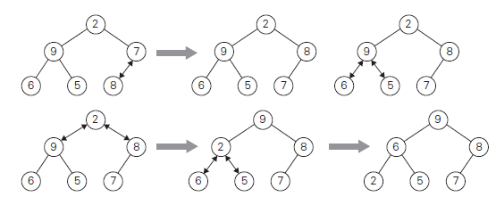
HEAPS – Construction of a Heap – (Bottom up approach)

Slide 9
HEAPS – Construction of a Heap – (Bottom up approach)
ALGORITHM HeapBottomUp(H[1..n])
//Constructs a heap from elements of a given array by the bottom-up algorithm
//Input: An array H[1..n] of orderable items
//Output: A heap H[1..n]
for i ←floor(n/2) downto 1 do
k←i; v←H[k]
heap←false
while not heap and 2 ∗ k ≤ n do
j ←2 ∗ k
if j < n
if H[j] < H[j+1] j ←j + 1
if v ≥ H[j ]
heap←true
else
H[k]←H[j]; k←j
H[k]←v

Slide 10
Analysis of Heap Construction Algorithm
Consider the heap is full i.e. n = 2^{k} − 1 so that a heap’s tree is full, (k is no. of levels)
Let h be the height of the tree
Each key on level i of the tree will travel to the leaf level h in the worst case of the heap construction algorithm.
Moving a key to the next level down requires two comparisons—one to find the larger child and the other to determine whether the exchange is required
The total number of key comparisons involving a key on level i will be 2(h − i).
Therefore, the total number of key comparisons in the worst case is
A heap of size n can be constructed with fewer than 2n comparisons

Slide 11
HEAPS – Construction of a Heap – (Top Down approach)
Top-down heap construction.
Let key ‘k’ be the new node value to be added to the heap.
Add ‘k’ to the heap.
Shift ‘k’ up to its appropriate place in the new heap as follows.
Compare ‘k’ with its parent’s key:
if the latter is greater than or equal to ‘k’, stop
otherwise, swap these two keys and compare ‘k’ with its new parent.
This swapping continues until ‘k’ is not greater than its last parent or it reaches the root.

Slide 12
To insert 10 into the heap
Obviously, this insertion operation cannot require more key comparisons than the heap’s height.
Since the height of a heap with n nodes is about log₂n, the time
efficiency of insertion is in O(log n).

Slide 13
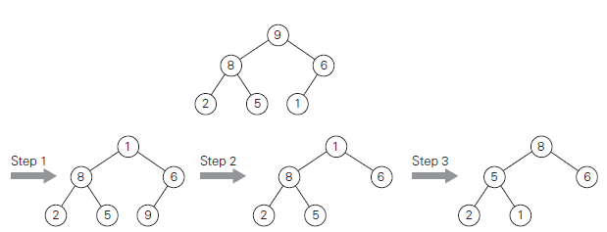
Deletion in a Heap
Maximum Key Deletion from a heap
Exchange the root’s key with the last key K of the heap.
Decrease the heap’s size by 1.
“Heapify” the smaller tree by sifting K down the tree verifying the parental dominance for K: if it holds, we are done; if not, swap K with the larger of its children and repeat this operation until the parental dominance condition holds for K in its new position.
Efficiency of deletion is determined by the number of key comparisons needed to “heapify” the tree approximately O(n log n)

Slide 14
Heap Sort
Two-stage algorithm
Stage 1 (heap construction): Construct a heap for a given array.
Stage 2 (maximum deletions): Apply the root-deletion operation n − 1 times to the remaining heap.
Perform Heap Sort for the given set of elements 2, 9, 7, 6, 5, 8
Stage 1 (heap construction)
2 9 7 6 5 8
2 9 8 6 5 7
2 9 8 6 5 7
9 2 8 6 5 7
9 6 8 2 5 7

Slide 15
Heap Sort
Stage 2 (maximum deletions)
9 6 8 2 5 7
7 6 8 2 5 9 (heapify)
8 6 7 2 5 9
5 6 7 2 8 9 (heapify)
7 6 5 2 8 9
2 6 5 7 8 9 (heapify)
6 2 5 7 8 9 (heapify)
6 7 5 2 8 9 (heapify)
7 6 5 2 8 9
2 6 5 7 8 9 (heapify)
6 2 5 7 8 9
5 2 6 7 8 9
2 5 6 7 8 9
2 5 6 7 8 9

Slide 16
Heap Sort - Efficiency
For heap construction(stage 1), efficiency is O(n)
For maximum deletions(stage 2), efficiency is O(n log n)
Therefore,
The efficiency of the heap sort algorithm is O(n) + O(n log n) i.e. O(n log n)
The efficiency of the heap sort algorithm in both the worst and average cases is Θ(n log n)
The efficiency of the merge sort algorithm is Θ(n log n), but heap sort doesn’t require extra space.
Timing experiments on random files show that heapsort runs more slowly than quicksort but can be competitive with mergesort

Slide 17
THANK YOU

